Slide 1

MINI PROJECT
JOB VACANCY
PROJECT

Slide 2
job4u
Presenting
EASY-TO-USE
BRANCH WISE SEPARATED
GOVERNMENT
JOBS
PRIVATE
JOBS
WEBSITE
INTENRSHIPS
Presentation Title

Slide 3

Introduction
Our project is all about providing the best website for engineering students to search jobs and Interships or to know about the current government vacancies available. People don’t have to waste their time by going through all the jobs for each branch.
We have divide our website according to the interest of the students and according to their branches.

Slide 4


PROBLEM STATEMENTS -People struggle to find employment in their preferred fields. -Many engineers with low level colleges find it difficult to land jobs through on-campus or off-campus placements. -Old jobs getting lost and new ones are hard to find. -Unawareness to new vacancies available. -Finding a user-friendly tool that displays information without being confusing may be challenging for novices.
To be solved

Slide 5




IMPLEMENTATION

Slide 6
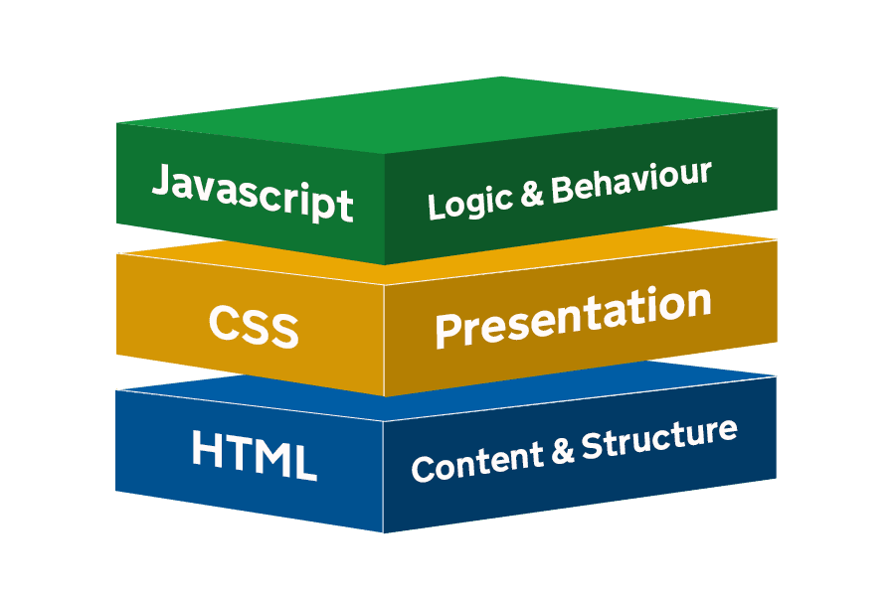
HTML
controls layout
provides structure for web page design
fundamental building block of any web page
CSS
applies style to the web page elements
targets various screen sizes to make web pages responsive
primarily handles the “look and feel” of web page
JAVASCRIPT
adds interactivity to the page
handles complex functions and features
programatic code which enhances functionability

Slide 7
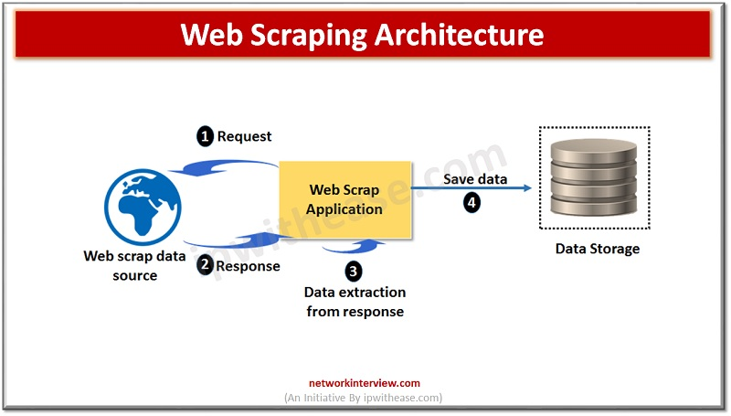

WEB SCRAPPING
Web scraping refers to the extraction of data from a website. This information is collected and then exported into a format that is more useful for the user.

Slide 8
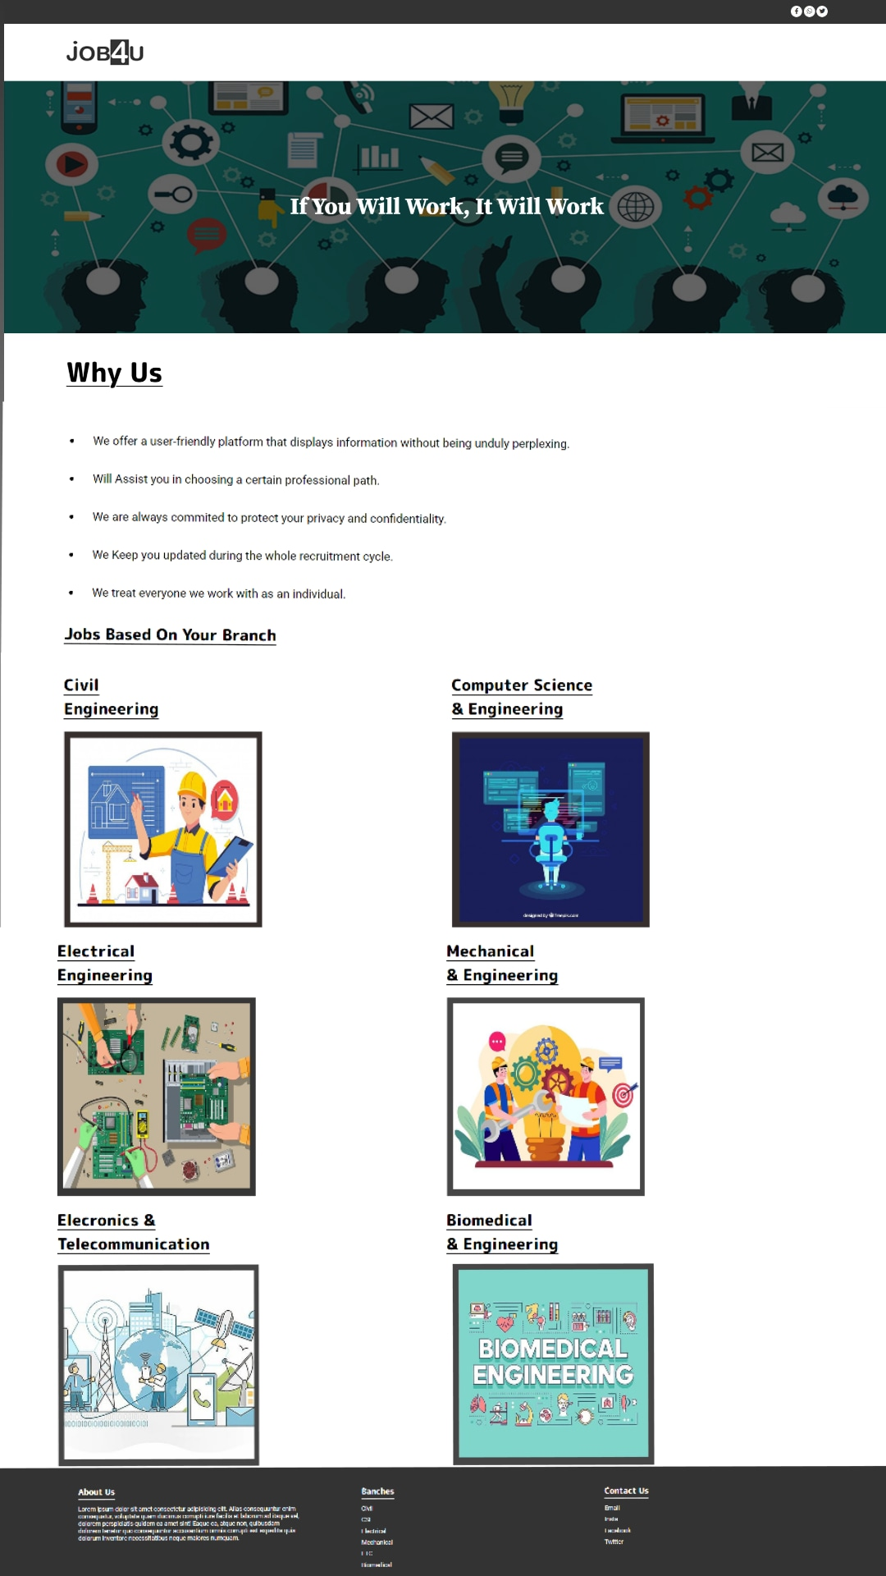
GLIMPSE OF THE WEB PAGE

Slide 9




Thank you
PRESENTED BY :
Adyali Agrawal
Sneha Bharti
Khushi Gedam
Bhumika Sahu
3rd SEM CSE Students

